Slide 1
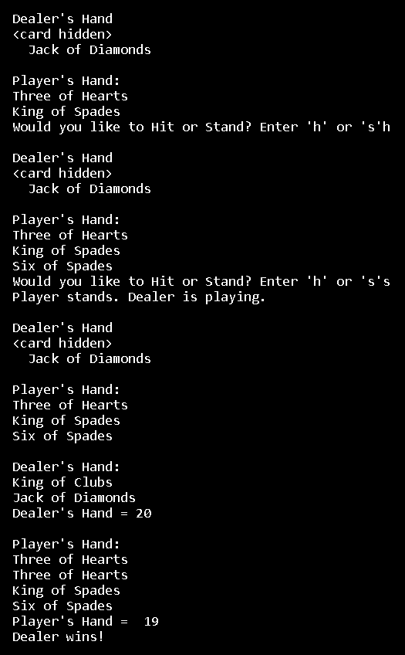

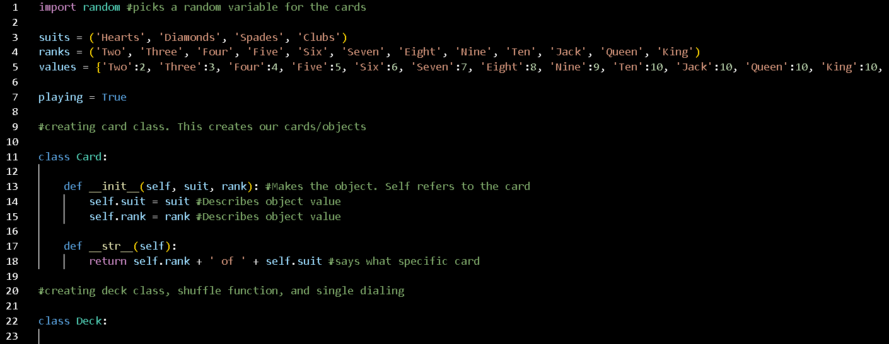

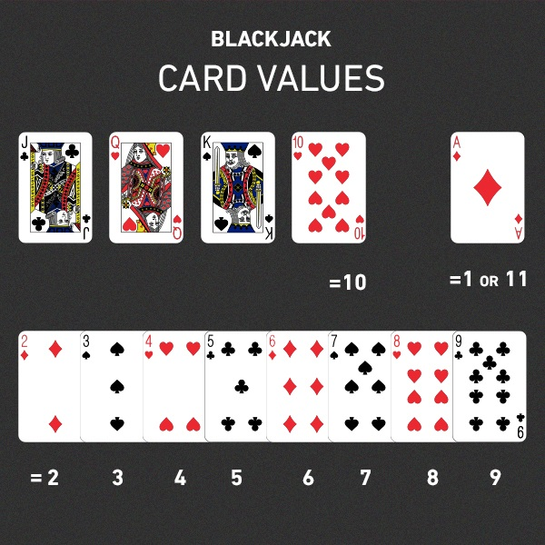
Black Jack
F INI SHED
PRODUCT
CODE
Description: A card game that allows multiple players to play against a dealer on the same computer. The goal is to beat the dealer's hand without going over 21!
Project Team Members: Deven Cross

